Slide 1
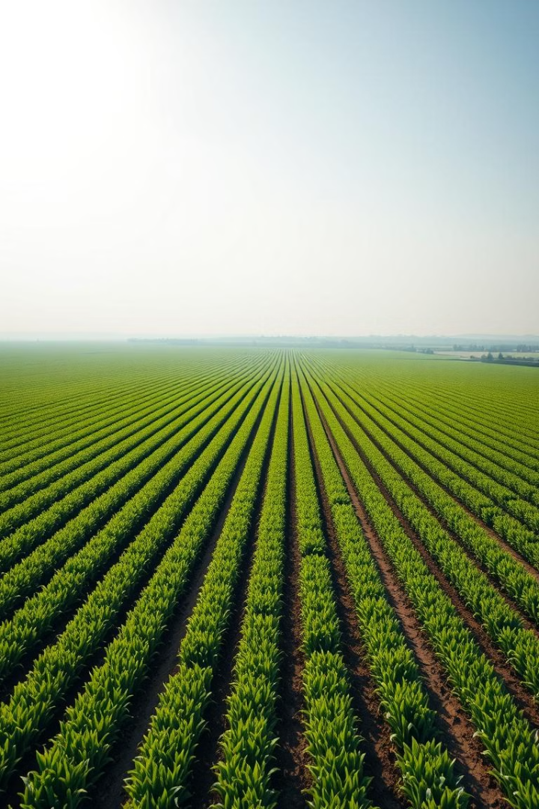

EverythingGoes
AI-Powered Food Sustainability: Empowering Farmers and Reducing Waste
Our platform revolutionizes food production and distribution, connecting farmers with consumers to minimize waste and maximize sustainability. By leveraging AI-powered forecasting and smart inventory management, we ensure that surplus produce reaches those in need, creating a more efficient and equitable food system. This innovative approach benefits farmers, businesses, and communities alike, paving the way for a more sustainable future. Join us in building a food system that is both innovative, practical, and sustainable.
by Hannah, Hemu, Sarthak and Angelica

Slide 2
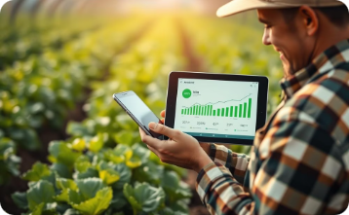
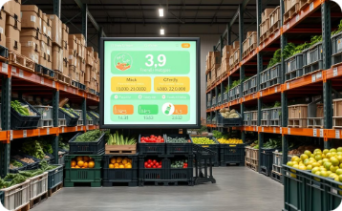
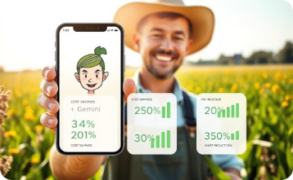
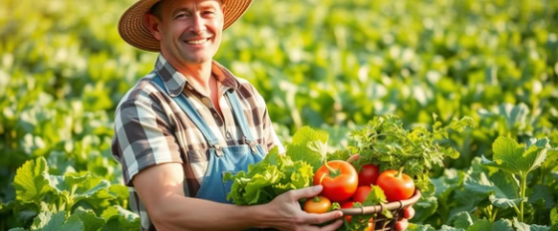
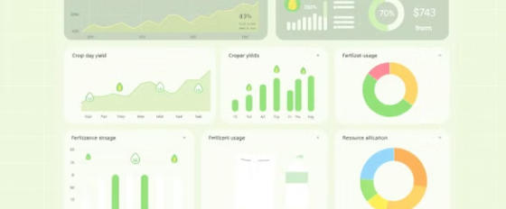
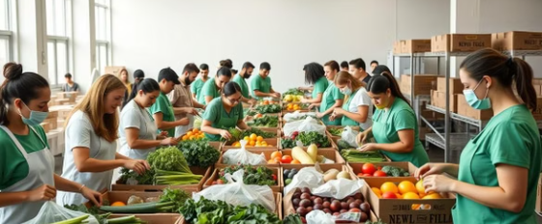
Empowering Farmers Through AI
Production Planning
Inventory Management
Smart Assistant
Farmers gain access to AI-powered demand forecasting, enabling them to optimize crop quantities and production efficiency. By anticipating market needs, farmers can minimize waste and maximize their yields, ensuring a more sustainable and profitable operation.
Our platform provides real-time stock tracking and expiration date alerts, allowing farmers to manage their inventory efficiently. Dynamic pricing features further optimize sales and minimize losses due to spoilage.
Through the Gemini integration, farmers receive AI-powered recommendations on how to optimize crop yield, food storage, and waste reduction. They can also track key performance indicators, such as costs, revenue, and waste reduction metrics, to make informed decisions.
Notes:
The GALLERY layout helps showcase the range of tools available for farmers on the platform, creating a visual overview of how the AI assists in optimizing production.

Slide 3

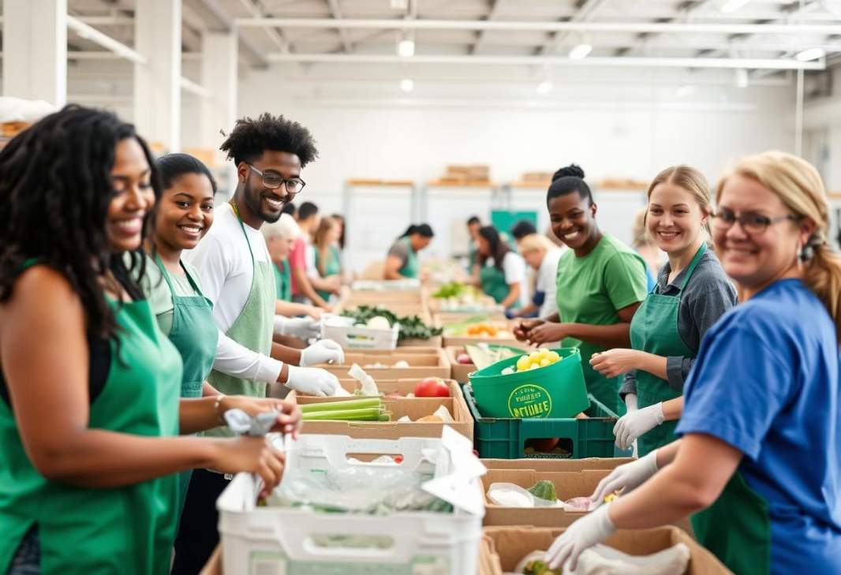
Connecting Businesses and Communities
Access the Marketplace
Businesses can connect directly with farmers through our business portal, providing access to a wide range of fresh produce and bulk discount opportunities. This direct connection ensures a steady supply of high-quality products for consumers.
Food Bank Coordination
Businesses can participate in our food bank donation system, ensuring that surplus produce is efficiently distributed to those in need. This collaborative effort minimizes food waste and supports communities by providing access to fresh, healthy food.

Slide 4








Advancing Sustainable Development Goals
Zero Hunger
Innovation
Optimizing food distribution to feed more people
Modernizing agriculture with AI systems
Partnerships
Responsible Consumption
Creating collaborative networks
Minimizing waste throughout supply chain
EverythingGoes directly addresses seven UN Sustainable Development Goals, creating meaningful impact across multiple dimensions of sustainability. By improving farmer incomes while increasing food access for vulnerable populations, we tackle poverty and hunger simultaneously.
Our innovative approach modernizes agricultural infrastructure while promoting responsible consumption patterns that reduce climate impact. Most importantly, we foster partnerships between diverse stakeholders—farmers, businesses, food banks, and communities—creating a collaborative ecosystem that amplifies our collective impact.

